Slide 1


Blind-zones Detection using Wide-angle Camera and Distortion Correction of Image for Automotive Applications
Mohammad Obydur Rahman
Master Automotive Software Engineering
Technische Universität Chemnitz
1st Semester
Matrikel-Nr.:712589

Slide 2
Outline
Inspiration
Introduction
Modern wide-angle camera technology
Principle of wide-angle camera operation
camera coverage from a distance
Distortion correction of wide-angle camera
Field of view of wide-angle camera reality
Conclusion
References

Slide 3
Inspiration
Approximately 80% of accidents are caused by objects in the blind zone.
A yearly economic loss of about 28.9 million dollars
Accidents and loss can be prevented and reduced through object detection in blind zones.
blind-zone wide-angle camera sensor
Wide-angle camera works like human vision
Country | Total crashes | Injury | Death | Year
Europe | 12,340 | 11,504 | 3,961 | 2005
United States | 13,576 | 9,160 | 4,522 | 2000
Japan | 9,543 | 6,387 | 2,873 | 2003
China | 17,453 | 14,398 | 6,345 | 2005
Motor vehicle crashes statistics in blind-zone

Slide 4
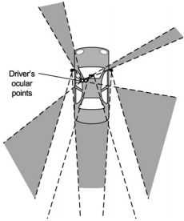
Introduction
Wide-angle camera uses a wider lens to magnify the distance between objects
Parallel lines converge at the same rate as with a normal lens
Shapes are symmetrical in front of and behind the diaphragm
Retro-focus lens solves proximity problem
Blind-zone detection using a wide-angle camera
Driver’s ocular position
Blind-zone
Blind-zone areas (shown in gray) of left-hand car[1]

Slide 5
Modern wide-angle camera technology
Object detection sensors in blind-zones are Camera, Radar, and Lidar
 | Camera | Radar | Lidar
Cost | $30 | $70 | $650
Noise detection | High | - | -
Resolution | High | Low | Medium
Classification | High | Medium | High
Colors and shapes | High | - | -
Comparison of Camera, Radar and Lidar
Camera is an essential, widely used, and inexpensive sensor
Wide-angle camera cover > 100° (Where standard lens camera cover 45°)
Stereo vision technology able to capture a 3D image [11]
3D semantic camera can detect the size, position, and composition of objects

Slide 6
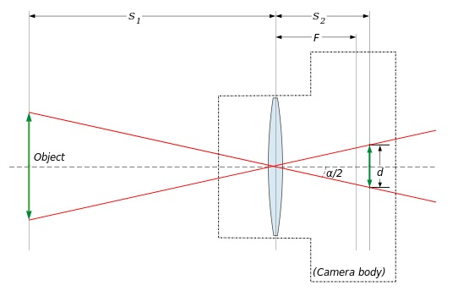
Principle of wide-angle camera operation
Wide-angle lens
S₁= Distance of object
S₂= Distance of pinhole
d = Dimension
F = Focal length
α/2 = Angle between optical axis
and ray joining its optical centre
α = Wide angle view
Retro-focus lens wide-angle camera[5]
Determination of angle view α :
$\tan{\text{(}\text{α}\text{/2}\text{) = }\frac{d/2}{S2}}$ => $\text{α}$= 2arctan$\frac{d}{2S2}$ (Where S₂=$\frac{S1∗F}{S1−F}$)

Slide 7
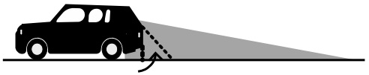
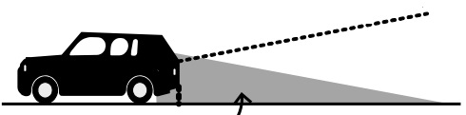
Camera coverage from a distance
Blind-spot
Coverage area
Coverage of standard lens camera (45° view)[2]
Wide-angle coverage area
Blind-spot
Coverage of wide-angle lens camera ( >100° view) [2]
135° Wide-angle camera cover blind-zone

Slide 8


Radial lens distortion correction of wide-angle camera
Division model for radial distortion inversion
R_{u}= $\frac{Rd}{1+\sum_{i=0}^{∞}{knRd2n}}$
R_{u}= $\frac{Rd}{1+k1Rd2+k2Rd4+…+knRd2n+… }$
Where
R_{d} = distorted radius
R_{u} = undistorted radius
K = coefficients of the polynomial

Slide 9
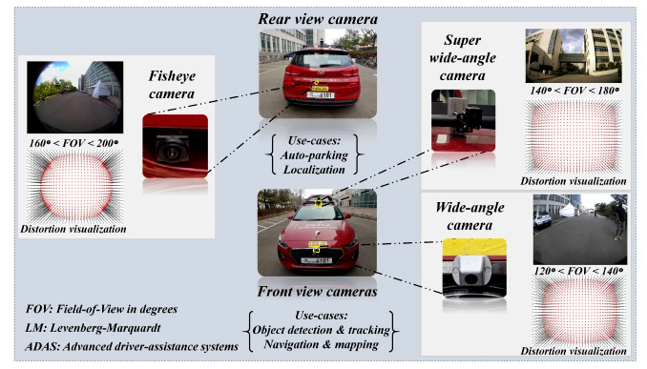
Field of view of wide-angle camera reality
Wide-angle camera with FOV in different positions [6]

Slide 10


Conclusion
Wide-angle camera works like human vision
3D semantic camera technology can detect the size, position, and composition
of objects
80% of accidents can be reduced
Wide-angle view $\text{α}$= 2arctan$\frac{d}{2S2}$
Division model for distortion removal
95% distortion removed from the image
R_{u}= $\frac{Rd}{1+\sum_{i=0}^{∞}{knRd2n}}$

Slide 11
References
[1] Brauer-Burchardt, C., and Voss, K.: ‘A new algorithm to correct fish-eye- and strong wide-angle-lens-distortion from single images’, Proceedings of the IEEE International Conference on Image Processing, Thessaloniki, Greece, October 2020, vol. 1, pp. 225–228
[2] UNECE Working Party on General Safety Provisions (GRSG): ‘GRSG-83-Inf15e: Outline of Draft Amendment to ECE Regulation No.46’ (Draft Requirements for Driver’s Field of Vision of Immediate Frontward and Sideward), 2022
[3] Fitzgibbon, A.W.: ‘Simultaneous linear estimation of multiple view geometry and lens distortion’, Proceedings of the IEEE Computer Society Conference on Computer Vision and Pattern Recognition, Kauai, Hawaii, United States, December 2001, vol. 1, pp. 125–132
[4] BRAUER-BURCHARDT C., VOSS K.: ‘Automatic lens distortion calibration using single views’. Mustererkennung, DAGMSymposium, Kiel, Germany, September 2021, pp. 187– 194
[5] “Angle of view” https://en.wikipedia.org/wiki/Angle_of_view accessed on 20th May 2023
[6] Kakani V, Kim H, Kumbham M, Park D, Jin CB, Nguyen VH. Feasible self- calibration of larger field-of-view (FOV) camera sensors for the advanced driver-assistance system (ADAS). Sensors. 2019 Jul 31;19(15):3369.

Slide 12
References
[7] World Health Organization, Ed., “Global status report on road safety 2018,” World Health Organization, 17-Jun-2018. [Online]. Available: https://www.who.int/publications/i/item/9789241565684. [Accessed: 06- May-2023].
[8] J. Kumar, “What is driving the automotive lidar and radar market?” What is driving the automotive LiDAR and RADAR market? 25-Jul-2017. [Online]. Available: https://www.electronicspecifier.com/products/sensors/what-is- driving-the-automotive-lidar-and-radar-market. [Accessed: 06-May-2023].
[9] Wang P. Research on Comparison of LiDAR and Camera in Autonomous Driving. InJournal of Physics: Conference Series 2021 Nov 1 (Vol. 2093, No. 1, p. 012032). IOP Publishing.
[10] Reversing camera – wide angle – Night view – 3 housing options – For car and camper – 12V (CAM030) [Online]. Available: https://www.calibereurope.com/en/product/CAM030-en_GB [Accessed: 02- 06-2023]
[11] Toulouse A, Drozella J, Motzfeld P, Fahrbach N, Aslani V, Thiele S, Giessen H, Herkommer AM. Ultra-compact 3D-printed wide-angle cameras realized by multi-aperture freeform optical design. Optics Express. 2022 Jan 17;30(2):707- 20.

Slide 13
Thank you

